Slide 1
Chapter 11.1 to 11.3 Hypothesis Testing - Testing a Claim

Slide 2
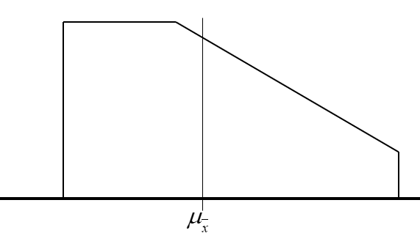
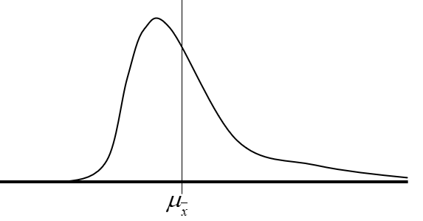
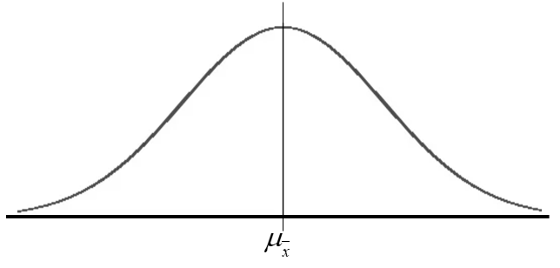
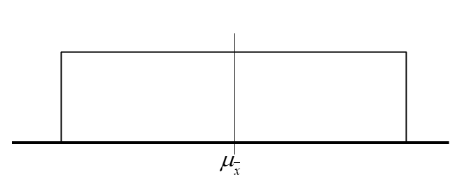
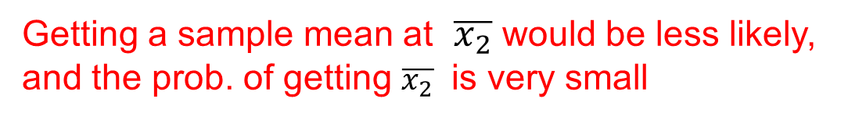

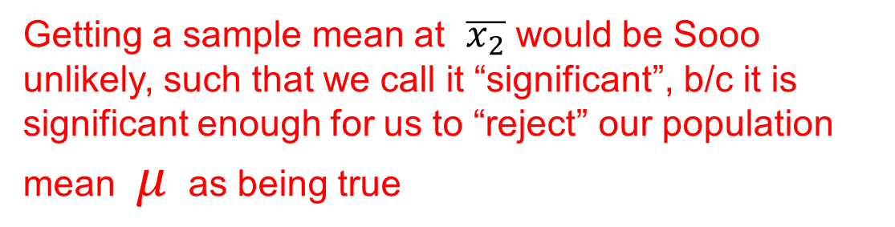
What’s important about this chapter?
Suppose we are given a population distribution:
If our sample size “n” bigger than 30, the sampling distribution of $\overline{x}$should be normally distributed [SRS & Independence]
Suppose we take one sample of size “n”, getting any sample within this distribution is likely
Getting a sample mean at $\overline{x_{1}}$ is very likely, and the prob. Of getting $\overline{x_{1}}$ is equal to this shaded area
Getting a sample mean at $\overline{x_{2}}$ would be less likely, and the prob. of getting $\overline{x_{2}}$ is very small
Getting a sample mean at $\overline{x_{2}}$ would be Sooo unlikely, such that we call it “significant”, b/c it is significant enough for us to “reject” our population mean $μ$ as being true
Population distribution can be “Uniform”
, “Irregular”
, “Skewed”
, OR “Normal”

Slide 3
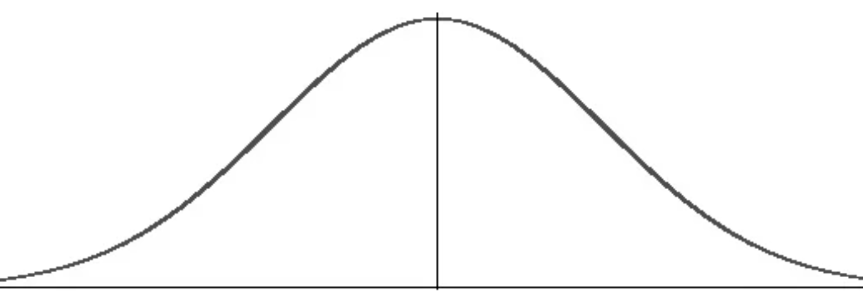
Hypothesis Testing and Probability
The purpose of this chapter is to perform an “hypothesis test”: a test to assess if an hypothesis about the population is true or not true
We always begin with a hypothesis with a claim that something from the parameter is true or equal to a certain value, ie: avg household income is $250k
Next we take a sample of “n” households and get a sample average, the distribution of our sample means would look like this:
95% of our samples would fall in this range:
If we are to take one sample, getting a sample average outside of this range should be unlikely
BUT what if we did get an average outside this range? Does this give us evidence to doubt our assumption? Our sample will then be “statistically significant” enough to reject our hypothesis

Slide 4
How to Perform a Hypothesis Test: STEP 1
The first step of a “hypothesis test” is to state your hypothesis – a statement about your population parameter of interest [BE PRECISE!]
There are two parts with stating your hypothesis
1) NULL Hypothesis – this part of the hypothesis always states that there is “NO” change with your parameter, or your parameter is “EQUAL” to a certain value
The notation for the Null Hypothesis is (Ho) and you always use an equal sign
2) ALTERNATIVE Hypothesis – this part of the hypothesis indicates that there is always “CHANGE” with your parameter
Your population mean is either bigger/smaller/ or “not equal” to a certain value. (Read the context to know <, >, or ≠ )
The notation for the Alternative Hypothesis is (Ha) and you NEVER use the equal sign

Slide 5

Ex: Suppose Jerry owns a grocery store and the average customer spends $120 with a std dev of $20. His good friend Chris decides to give him a lucky charm to help boost his business. Next week Jerry takes a random sample of 50 customers and the sample average was $150.
a: What is the parameter of interest?
b: State the NULL Hypothesis, explain it context
c: State the ALTERNATIVE Hypothesis
d) How did you determine if Ha is either > , < , or ≠ ? Explain:
The average amount of money a customer would spend at Jerry’s grocery store
Customers spend an average of $120 after Lucky Charm is received
In context, the lucky charm did not help increase customer spending
Customers now spends an average more than $120
In context, after getting the lucky charm customers increased their spending at the grocery store
Since the context was about “increasing” customer spending, our Ha will use the “greater than” notation

Slide 6
Ex#1) Indicate the Null Hypothesis and Alternative Hypothesis for each scenario:
A hospital allocated money to improve paramedic response times. Last year, the average response time was 6.7minutes (sd=2 min). This year a sample of 400 responses had an average of 6.48 minutes. The hospital wants to know if response times have improved?
The average paramedic response time is equal to 6.7minutes
The average paramedic response time is less than 6.7 minutes
In context, Ho states that there is “NO” improvement with avg PRT
Ha states that there is an improvement with avg PRT, money well spent
A company claims that their light bulbs will last 800 hours of use. A consumer samples a number of light bulbs and tests if the average lifetime is actually 800 hours.
The average light bulb lifetime is 800hours
The average light bulb lifetime is not equal to 800 hours
Since the test isn’t about more than 800hrs or less than 800hrs, the alternative would therefore be “NOT EQUAL”

Slide 7
At Wing’s bar and grill, an order of chicken wings is supposed to weigh 2 pounds. From experience, the weights of chicken wings order follow a Normal distribution with standard deviation of s = 0.13 pounds. You believe that the new chef is making orders that are heavier than 2 pounds
The average weight of a chicken wings order is equal to 2 lbs
The average weight of a chicken wings order is more than 2 lbs
Pringles advertises that there is only 2mg of sodium in their chips per serving. A consumer wants to know if there is any false advertising
A serving of Pringles chips has an average of 2mg of sodium
A serving of Pringles chips has an average of more or less than 2mg of sodium
In the past, the mean score of math 12 students in the ch3 test is 67%. This year, technology has been supplemented in the classroom. The mean score on the ch3 test is 72%. Has the use of technology in the classroom affected student average on the ch 3 test?
The mean score of M12 students in Ch3 is 67%
The mean score of M12 students in Ch3 is NOT 67%

Slide 8
11.6) Here are several situations where there is an incorrect application of Hypothesis testing. Explain what is wrong in each situation:
a) A change is made to improve student satisfaction on cafeteria food. The null hypothesis, that there is an improvement, is tested versus the alternative, that there is no change
b) A researcher tests the following null hypothesis:
c) A climatologists wants to tests the null hypothesis that it will snow tomorrow
d) Null Hypothesis: Paramedic Response time is 6.5 minutes
e)
H₀ and H_{a} have been switched. The null hypothesis should be a statement of no change
H₀ should be a statement about µ, not x.
¯
Our hypothesis should be a claim about the population. Whether it rains or not is not such a statement
Missing “mean” or “average” in your null hypothesis

Slide 9
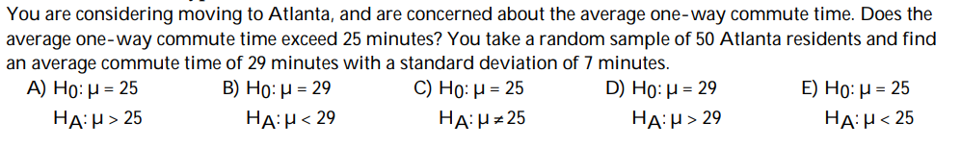
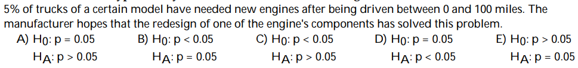
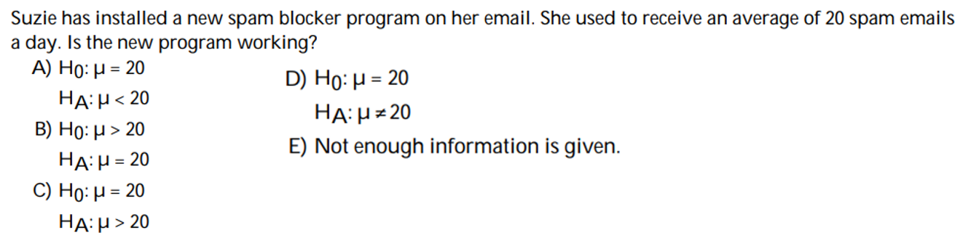

Slide 10
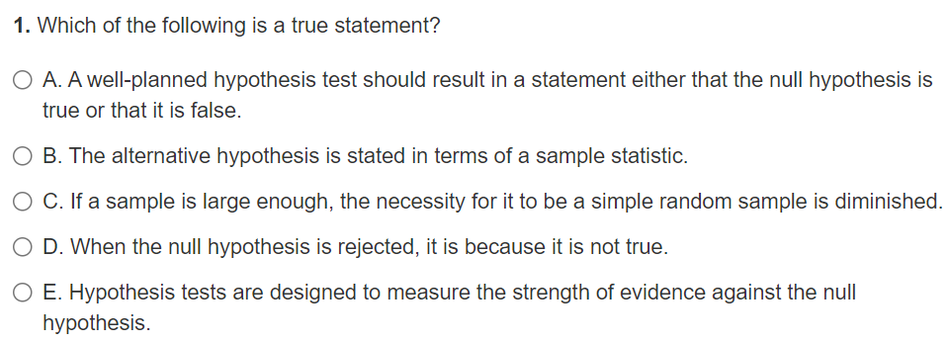

Slide 11
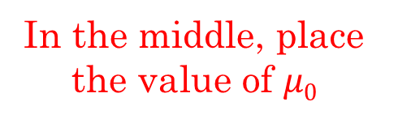
Number Line Method With Hypothesis Testing
A company wants to test if their chips are fast enough for processing. They need to be at least 300gb/s to be sold. A random sample of 50 chips were taken and the average speed was 275gb/s. State the Null and Alt Hyp.
Start by drawing a number line
In the middle, place the value of $μ0$
Scenario 1:
The middle is ALWAYS part of the NULL (Ho)
Chip Don’T work
Chip works
Chip works
The next step is to choose which side is also part of the NULL “ATLEAST”
The mean speed of the chips is 300gb/s
(chips work)
The mean speed of the chips is less than 300gb/s
(chips DON’T work)

Slide 12
Number Line Method With Hypothesis Testing
A company wants to test if their chips are fast enough for processing. They need to be at least 300gb/s to be sold. A random sample of 50 chips were taken and the average speed was 275gb/s. State the Null and Alt Hyp.
Start by drawing a number line
In the middle, place the value of $μ0$
Scenario 2:
The middle is ALWAYS part of the NULL (Ho)
Sides are switched
Chip works
Chip works
The next step is to choose which side is also part of the NULL “ATLEAST”
There’s NO test, both Ho and Ha have the same test that chips work
There’s ONLY ONE of two cases that work

Slide 13
Hypothesis Testing with Inequalities in the Null:
#1) A tutoring company claims that students will increase their mark by 15% or more after two months of tutoring. A random of 120 students that attended the tutoring center were selected. The percentage difference in mark were recorded. State the Null and Alternative Hypothesis
#2) The acceptable amount of fluoride in drinking water can be no more than 1.5mg per litre. In Denver, Colorado fluoride concentration is unusually high. The state wants to test if flouride concentration is over acceptable limits. A random sample of 50 tests showed an average of 0.9mg per litre.
#3) Retail stores in Metrotown will decrease their spending on security if the average cost of merchandise stolen each month is $500 or less. From a cost perspective, some executives believe it is cheaper to let goods be stolen than commit to salary. A test will be taken to justify cutting security costs.

Slide 14
#1) A tutoring company claims that students will increase their mark by 15% or more after two months of tutoring. A random of 120 students that attended the tutoring center were selected. The percentage difference in mark were recorded. State the Null and Alternative Hypothesis
Tutoring Didn’t Work
Tutoring Works
Tutoring Works
The mean increase in test score for students that had tutoring is 15%
The mean increase in test score for students that had tutoring is LESS than 15%

Slide 15
The acceptable amount of fluoride in drinking water can be no more than 1.5mg per litre. In Denver, Colorado fluoride concentration is unusually high. The state wants to test if flouride concentration is over acceptable limits. A random sample of 50 tests showed an average of 0.9mg per litre.
Concentration is acceptable
Concentration is acceptable
Concentration is NOT acceptable
The mean concentration of flouride of drinking water in Denver is 1.5mg/L
The mean concentration of flouride of drinking water in Denver is MORE than 1.5mg/L

Slide 16
STEP 2: Determining a Significance Level ()
The next step is to determine a “significance level” () [alpha]
Your significance level is a threshold – a percentage level used to determine whether to 1. Reject the Null Hypothesis: “Reject Ho” or 2. Not Reject your Null Hypothesis : “FAIL to Reject Ho” [Never say you “Accept Ho”]
Usually, significance level is 1%, 5%, or 10%, depends on the question
Note: the probability of your sample is a conditional probability: Given that the mean is true, what is the probability that you will get this sample statistics?
QUOTE: “an outcome that would rarely happen if a claim were true is good evidence that the claim is not true”
If the probability of getting your sample is larger than  → your sample is NOT statistically significant → “Fail” to reject the null hypothesis [Remember: You are testing against the Null Hypothesis]
If the probability of your sample is less than  → Your sample is statistically significant → you would reject the null hypothesis and accept the alternative

Slide 17
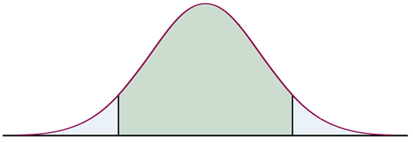
Step 3: Take a Sample and Calculate the P-value
Take a sample and get your statistics, your sample mean
The P-value is the probability of getting your sample mean + all cases that are more extreme “GIVEN” that the Null Hypothesis was true
The P-value can be either “ONE-Tail” or “TWO-Tail”, depends on your Alternative Hypothesis: Need to consider the context of the question!!
The Alt. Hyp. is “ONE-Tailed” if it is either “greater only” or “less than only”
Business got worse [LEFT Tail]
Business improved [Right Tail]
P-Value
P-Value

Slide 18
Your Alternative Hypothesis is two Tailed if it uses the “NOT EQUAL” sign
Business is different, could be better or worse [TWO TAIL]
If we are calculating the probability, we need the probability of “ALL” cases as extreme as our sample mean
P-Value

Slide 19
What you NEED to KNOW about P value
The P-value is a CONDITIONAL probability
To find your P-value, you MUST have a Sample Mean
The “GIVEN” part is that the NULL is TRUE, which means our P-vaue depends on the sampling distribution from the NULL hypothesis
The probability is an “AREA”, which means it’s the probability that involves the sample mean and all cases that are more extreme
Which extreme side the P-value heads towards depends on the Alternative Hypothesis!!

Slide 20
TRICKY Example!
WHICH SIDE IS THE P-VALUE??

Slide 21


Ex: Find the P-value for each of the following
i) Prior to renovation, your customers spend $35 on average with a std dev of $4. Post renovation, your SRS of 50 customer spends $40. Did average customer expense increase after the renovation? Find the P-value. Use “Ha” to determine if average it is one tail OR two tail.
This is a one tail Test b/c Ha:$μ$> $35
Pop. Mean is $35
Sample mean is $40
Pringles advertises that there is only 2mg of sodium in their chips per serving with a std dev of 0.45mg. A consumer wants to know if there is any false advertising. You took a box of 50 sample and found and average of 2.5mg of salt per serving. Find the P value, explain if it is one tail or two tail.
This is a two tail Test b/c you are not testing only for more or only for less. Since we are testing if their claim of 2mg per serving, the alternative hypothesis would be not equal to 2mg.
Pop. Mean is $2mg
Std Error: $\frac{0.45}{\sqrt{50}}$
Sample mean is $2.5

Slide 22
Step 4: Compare P-Value Against Significance level
The P-value is a conditional probability: the probability of getting your statistics given the parameter from your Null Hypothesis
QUOTE: “an outcome that would rarely happen if a claim were true is good evidence that the claim is not true”
If P-value >  → Sample is NOT statistically significant → Fail to Reject Ho
If P-value <  → Sample is statistically significant → Reject Ho
If your P-Value is “LOW” , then REJECT the NULL “HO”

Slide 23
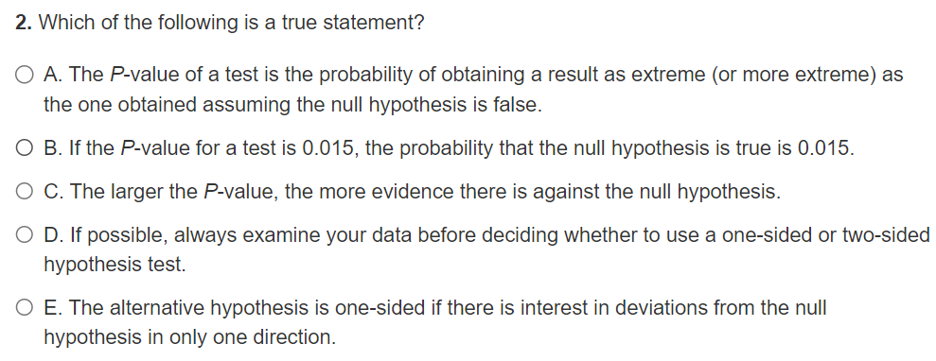

Slide 24
Summary on Hypothesis testing:
Begin with the Null and Alternative Hypothesis:
Null is always equal/no change
Alternative depends on the context of the question: > , < , or ≠
Your hypothesis should be about a parameter [population mean]
Determine the significance level α
The significance level is usually given to you: 5%, 10%, or 1%
Get a sample statistics and Calculate the P-value
Use the sample mean to calculate your P-value [conditional probability]
Your P-value depends on how many tails [Alternative Hypothesis]
Compare your P-value against your significance level
If P-value >  → Sample is NOT statistically significant → Fail to Reject Ho
If P-value <  → Sample is statistically significant → Reject Ho

Slide 25
Ex: Suppose Jerry owns a grocery store and the average customer spends $120 with a std dev of $20. His good friend Chris decides to give him a lucky charm to help boost his business. Next week Jerry takes a random sample of 50 customers and the sample average was $150.
a: Will your P-value be ONE Tail or TWO Tail? Explain
b) What is the P-value of your statistics? Show all your Calculations:
c) Suppose your significance level is 5%, will you “Reject” or “Fail to Reject” the Null Hypothesis. Explain
Our P-value will be One Tail b/c the Alt Hypothesis is that the customers are spending on avg more than $150
The probability of getting our sample statistics if our Null was true is very small, almost impossible.
Our P-value is less than the significance level of 5%. Thus we would “REJECT” our null hypothesis and accept the alternative hypothesis that customer are spending more than $120 on average.

Slide 26
What does it Imply when we Reject Ho?
Our Null Hypothesis claims that this is our sampling distribution and the population mean is equal to $120
When we take a sample that is “statistically significant”, it means that the conditional probability of getting such a sample if “Ho” was true would be very small
So either our sample mean is false Or the population mean is false. BUT, we can’t reject our sample, so we reject the population mean
Rejecting the population mean implies that the “yellow” sampling distribution is incorrect
Instead, our sampling distribution should have a mean that is bigger
If the blue sampling distribution was TRUE, then getting our sample statistics would be more likely

Slide 27
STEP 5: Accept or Reject the Null Hypothesis Ho
If your P-value is smaller than your significance level , then it suggests that H_{o} is likely False → “we reject Ho and accept the alternative hypothesis” (Ha)
The results from the sample is very unlikely to happen if the population mean was true. Therefore, population mean is incorrect.
If P-value is greater/equal to the significance level , then you would “Fail to reject the Null hypothesis (Ho) and reject Ha”
Never say that you “accept” Ho [never accept the Null hypothesis, only say that you Fail to reject it!!]
Ie: Suppose your significance level is 1% and you have a small P-value of 0.005
P-value is less than the significance level of 1%, therefore, we would reject the null hypothesis (Ho) and accept the alternative hypothesis (Ha)
Suppose your P-value is 5%
P-value is greater than the significance level of 1%, therefore, we would fail to reject the null hypothesis (Ho) and we would reject the alternative hypothesis (Ha)

Slide 28
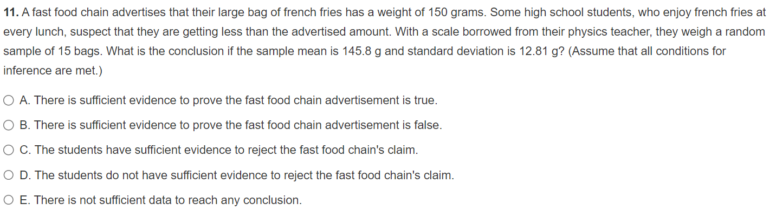

Slide 29
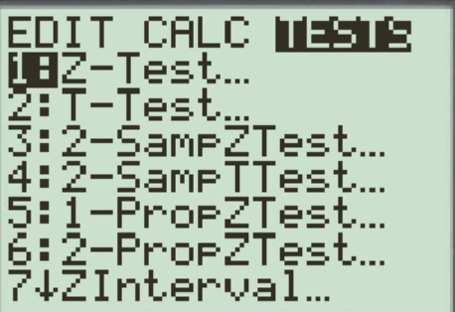
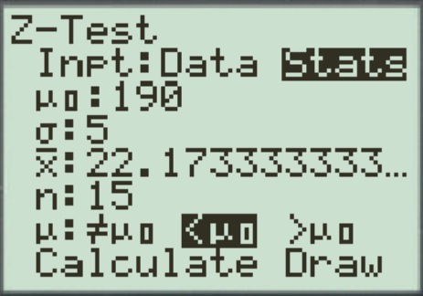
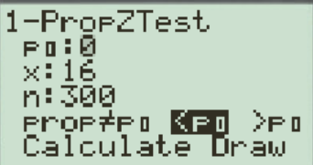
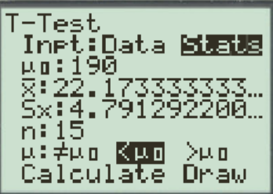



Performing an Hypothesis Test on Ti83
When performing an hypothesis test on a Ti83, it mainly calculates the P-value for different types of distributions
1. Z-Test is used if the population standard deviation is given and we are test against a population “MEAN”
2. T-Test is used if the population standard deviation is NOT given, instead we replace it with “s” sample std deviation . We are also testing against a pop. “MEAN”
5. 1-Proportion Z-Test is used if we are test against a Population “Proportion”
For the Alternative Hypothesis:

Slide 30
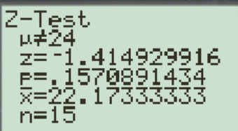
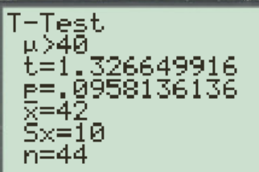
Reading the Output of a Hypothesis Test:

Slide 31
Formulas for Z-Test, T-Test, 1-Proportional Test
Z Test:
Test Statistics
P-Value
Population Std Deviation is given
T Test:
NO Population Std Deviation
To calculate the P-value with a T-distribution, we need to use our Test statistics!
Can’t USE Normal CDF!!
1 Sample Prop. Test
Population proportion from your Null Hypothesis is P₀

Slide 32
Step 4: Use your sample mean to calculate the “P value”
P-value is the probability of obtaining our sample mean “IF” the Null Hypothesis (Ho) was true
In the context of our store question, assuming that the customers on average spend $120, what is the probability that our sample will yield a mean of equal to or greater than $150
To find the P-value, use normalcdf or use “z-score” from our sample mean
The z-score will be used to calculate the probability percentage of our P-value

Slide 33

Ex: Paramedic response times were measured. Last year, the average response time was 6.7minutes (sd=2 min). This year a new training program was implemented and a random sample of 400 responses had an average of 6.48 minutes. Has response time decreased? a) State the two Hypothesis [Ho and Ha] in context b) Perform a test at a significance level of 1%, then calculate the P-value from your statistics. Is it one tail or two tail?
c) Provide a concluding statement on whether if you think response time decreased
d) What conclusion would you have if your significance level was 5%

Slide 34
Null → average paramedic response time did not change and is at 6.7minutes
Alt → average paramedic response time decreased and is less than 6.7minutes
P- value: Is it one tail or two tail?
One tail → only lower end, testing if response time have improved
We will perform a 1% significance level test
Our p-value of 0.0139 is greater than our significance level of 1%. Therefore, we failed to reject the Null Hypothesis. This suggest that the mean response time did not improve and is 6.7 minutes. This also suggest that our improved sample mean of 6.48min was due to sampling variation
If we increased our significance level to 5%, then our P-value is less than 5%. This will be evidence against the null hypothesis Ho and thus reject it. This suggests that the mean response time has improved and is less than 6.7 minutes.

Slide 35
The average response time in our sample (n=50) was 6.48minutes, which is 0.22 minutes faster (13.2seconds). SE = 0.1min = 6 seconds. Our average was over 2 standard errors less than the mean in our null hypothesis. Isn’t this strong evidence that the response time had decreased? How would you respond to someone that insisted we reject Ho??
a) Would you say that the sample could be bias? That there was error in the sampling process and they may have just taken the shortest times?
b) Would you say that perhaps we should reject Ho, since 2 standard errors below does seem like good evidence for the alternative hypothesis
c) How would you respond???

Slide 36
EX: The mean score of Moscrop students writing the Euclid contest is 50points. This year Advanced Algebra is offered for the first time, and 53 seniors that plan to take the Euclid contest enrolled in the preparation course. The sample had a mean score of 53 54.1 points with a standard deviation of 8. The principal believes that the new course has improved the students’ contest scores. Assume that Euclid scores and difficulty are consistent every year.
A) Identify the population and parameter of interest. State the two hypotheses in contest.
B) Identify the conditions required to do a significance test. Indicate what tests you are to do and explain why.
C) Perform a 1% significance level test with our statistics. Calculate the test statistic and the P-value. Is it one or two tail, explain. State your conclusion in context.

Slide 37
Parameter of Interest:
The mean score of Moscrop Students taking the Euclid scores and also enrolling in Advanced Algebra course.
Ho: μ= 50 The average Euclid score from Moscrop students enrolling in Advanced Algebra is 50 points Ha: μ> 50 The average Euclid score from Moscrop students enrolling in Advanced Algebra is more than 50 points
The conditions required to perform a hypothesis test are: 1. SRS – our sample is NOT a random sample but a sample of students from the same year. Thus there could be confounding in our sample, where the students writing the Euclid this year can be particularly strong. So we can not generalize our results to all future senior students taking the Euclid contest with the preparation course.

Slide 38
2. Independence: We can assume independence since the score from one student is independent on another.
3. Normality: Since our sample is greater than 30, we can assume that the sampling distribution of sample means is normally distributed. This is the Central Limit Thm.
4. We are not given the population standard deviation, so will be performing a “T-Test” for population mean.
Test Statistics: [Finding the Z-score or T-score]
Our P-value of 0.000236501 is statistically significant enough for us to reject the Null Hypothesis that the mean Euclid score of Moscrop students enrolling in Advanced Algebra is 50 points. Instead, we accept the alternative hypothesis that the mean Euclid score of Moscrop students have improved.

Slide 39

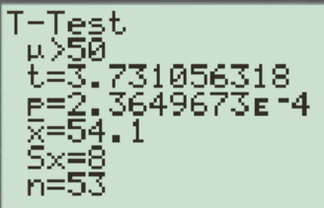
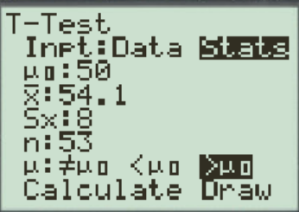
Note:
Since our sample was not a SRS, we can not generalize our results to all future students.
We can not claim that taking the prep course “CAUSED” an increase in seniors’ contest scores. This was not a controlled experiment

Slide 40
Ex: A cancer research group surveys 1000 men (age>50) to test the hypothesis that 30% of men in this age group have annual scheduled prostate screening. Should the hypothesis be rejected at the 1% significance level if only 275 men responded yes?
a) What is population of interest and state the Null and Alternative hypothesis?
b) Is this an one-tail or two tail hypothesis? Explain
c) What are the conditions required to perform an inference test? Are all conditions met? What test will you perform?
d) Calculate the P-value? Find your test statistics.
e) Interpret the results of your test in the context of this question.

Slide 41
1. State the hypothesis and also in context :
The proportion of 50 year old men or older (50+) who have annual prostate screening is 30%
The proportion of 50 year old men or older (50+) who have annual prostate screening is not 30%
b) This is a 2 tail test since the alternative hypothesis is NOT equal to 30%
C. Check conditions
SRS: it is not stated that the sample is SRS, but we will assume that it is
Normality: pop. is not stated to be normal
Independence: Since we are sampling without replacement, the population size must be 10 times your sample size. The population of men over 50 is 10 times the sample of 1000 men.

Slide 42
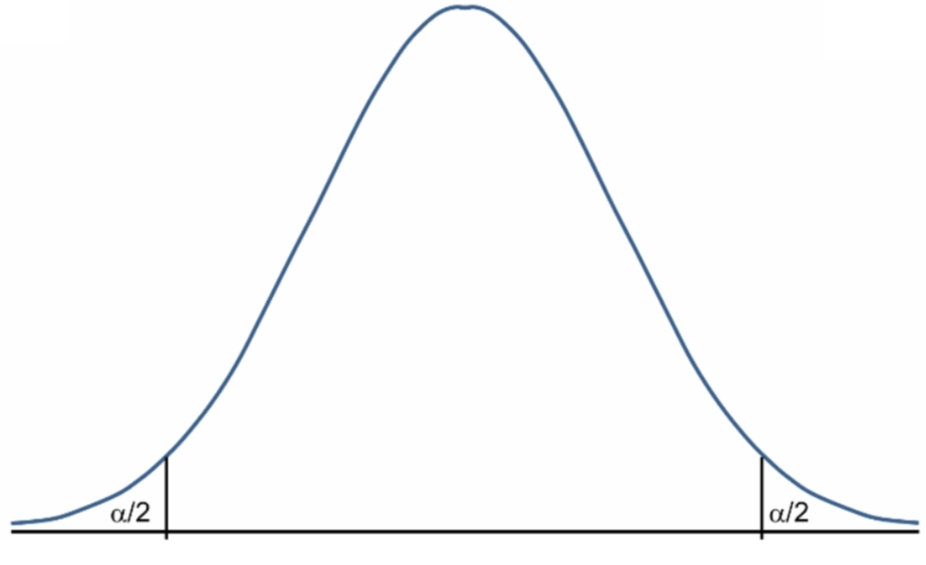
d. Find P value (2sided)
To calculate the z-score we need the SD
TEST STATISTICS
To find the P-value, Looking for area of both tails
Since our P-value is greater than our significance level (0.01), there is not sufficient evidence to reject Ho. Therefore, we would accept our Null hypothesis and accept the claim that 30% of men in the 50 plus age group are getting annual prostate screenings

Slide 43
Indicate True/False for each of the following statements:
i) The P-value is the probability that the null hypothesis is true
ii) A P-value is the probability the null hypothesis is true given a particular observed statistic
iii) A P-value is a conditional probability
iv) Large P-values are evidence against the null hypothesis because they say that the observed result is unlikely to occur when the null hypothesis is true
vi) The P-value is that probability that we will obtain the statistics from our sample, assuming that the null hypothesis is true
False
False, Ho is already assumed to be true
True, Ho is given to be true, find prob of the statistics
False, small P-values are evidences against Ho
True, this is what the P-value is!

Slide 44
PAIRED T - TEST
Does drinking caffeine help you type faster? A SRS of 15 subjects were asked to type a page of words in 6 minutes after consuming a cup of caffeine. In another test session, they were in a control group with a placebo and asked to type as many words in 6min. The data below shows their results.
a) State your Null and Alternative hypothesis, also in context. Make sure to define your variables of interest
b) State your conditions for performing a 1% significance test
c) Perform a pair t-procedure test to determine if caffeine helped increased number of words typed
d) Would you be finding a z-score or t-score? Explain
e) What is your P-Value?
f) Interpret your results in the context of this problem

Slide 45
a. State the hypothesis and also in context :
The mean difference in typing speed with taking caffeine and not taking caffeine is zero
The mean difference in typing speed is with taking caffeine and not taking caffeine is greater than zero
Another way to write your hypothesis is as follow:
The average typing speed with taking caffeine and not taking caffeine are the same
The average typing speed with taking caffeine is greater not taking caffeine
b. Check conditions
SRS: it is stated that the sample is SRS
Normality: Although the sample size is not 30, we can plot the differences in scores into a boxplot. Since there are no outliers in the sample of differences, we can assume that the distributions of sample means of differences are normally distributed
Independence: It is safe to assume that the typing speed of one student is independent of another

Slide 46
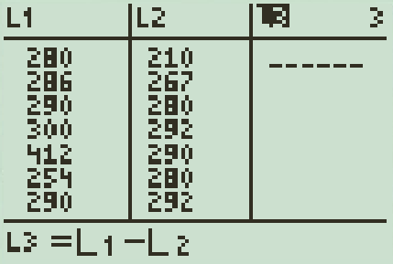
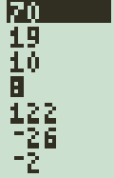
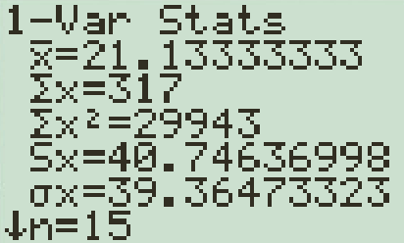
c) To do a paired T-distribution test, set L1 and L2 as the data set for Caffeine and Non Caffeine typing speed respectively
Set L3 as the difference in typing speed. Then do a 1 Var stat test on L3 for the mean difference in typing speed and the sample standard deviation too
We will continue on with our test in parts d, e, and f
D) Find your t-score because we are using a t-distribution. No population standard deviation is given
e) Now find the P-value
Since our P-value is greater than our significance level (0.01), there is not sufficient evidence to reject Ho. Therefore, we would accept our Null hypothesis and accept the claim that caffeine does NOT increase typing speed.

Slide 47
In the past, the mean score of the seniors at South High on the American College Testing (ACT) college entrance examination has been 20. This year, a focus on stress management was implemented on all 53 seniors planning to take the ACT. The mean of their 53 ACT scores is 22.1. The principal wants to know if helping students managing stress affected their ACT scores. Assume that ACT scores for seniors at South High vary Normally with standard deviation 6.
A) Identify the population and parameter of interest. State hypotheses in both words and symbols for testing the principal’s claim.
B) Identify the appropriate statistical procedure and verify conditions for its use.
C) Calculate the test statistic and the P-value. Is it one/two tail, explain. Illustrate using a graph.

Slide 48
Significance Level:
The significance level is usually given to you and not something that you need to calculate
The Sign. Level is usually a small percentage value like 1% (1/100) or 5% (1/20) or 0.05 (1/200)
It’s a percentage that you will use to test against your P-value
Main idea: Assume Ho is true/given, what is the probability our sample will obtain the following statistics (mean & SD)
What this means? Assuming/given that our Null Hypothesis true,
what is the probability that our sample will get a mean greater or equal to $40

Slide 49
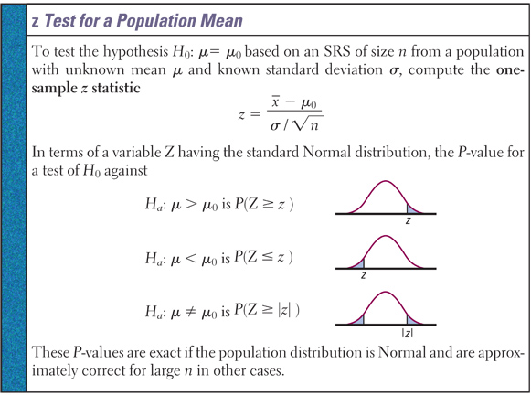

Slide 51
Suppose the wide density curve is the population distribution of how much each customer spends at jerry’s shop. $μ_{o}=$ 120 and $σ=\$12$
This tighter distribution is the distribution of sample means for sample sizes of 50 .
After getting his lucky charm from Chris, he takes a sample of size 50 and gets a sample mean of $150
This gives us evidence that there should be a New population distribution with a larger mean
When you take a sample of 50, you would expect 99% of the sample means to be within 3 standard errors of your assumed population mean!!
So what went wrong??!?!? 1. Jerry’s sample was bias [not likely if his sample was SRS] 2. Population mean is actually bigger than what was assumed: it increased (changed)
What is the probability that you will get this sample if μ_{o} was true? [P-value]
Our P-value is so small, that it’s unlikely that $μ_{o}=$ 120. “Reject our Null Hypothesis

Slide 52
Significance Test!
Suppose Jerry owns a grocery store and the average customer spends $120 with a std dev of $20. His good friend Chris decides to give him a lucky charm to help boost his business. Next week Jerry takes a random sample of 50 customers and the sample average was $150.
Q: What is the population parameter?
Q: Is there any evidence that customer spending increased?
Q: Is the sample good enough evidence that the population parameter could be bigger?
Q: What is the probability that you will get your sample mean if the population mean was true?
QUOTE: “an outcome that would rarely happen if a claim were true is good evidence that the claim is not true”
Q :
If the probability of getting this random sample is less than your significance level {limit}, then you reject the parameter which you thought was true.

Slide 53
Conditions for Performing Significance Test:
There are 3 conditions that must be satisfied in order to conduct a significance test, where we use statistics to test against a parameter
1. The sample must be a simple random sample and each observation must be Independent from one another
2. Checking for Normality: (Central Limit Thm)
NOTE: Population distribution is normal or sample size is greater or equal to 30
Proportion: np>10 and nq>10
3. Independence: The population size must be 10 times or greater than the sample size. If this condition is met, the distribution of x is normal with a standard deviation of
¯

Slide 54
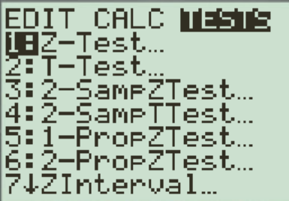
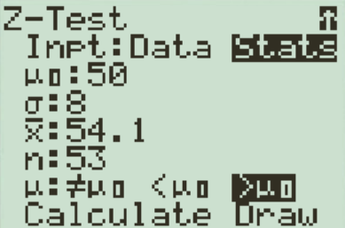
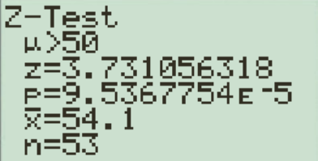
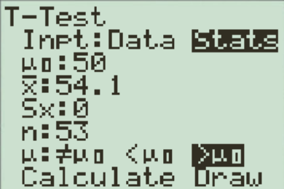

Slide 55
If you picked “a” and said used sampling bias as a reason, then you need start thinking deeper in statistics. The question says that a “random sample” was used, so move on from using “bias” as a go to response.
If you picked “b’, you fail to understand that purpose of statistics. You are suppose to use your data to support your argument. How unlikely is it to have sample mean of two SE below your mean? The probability is small but not impossible.
If you picked ‘c”, what would you say?
Although our sample mean showed evidence of shortened response time, our sample mean can still be obtained because of sampling variability. If the Null Hypothesis was true, the probability of getting our sample was greater than 1/100. Which is not impossible.

